Slide 1

INTRODUCTION
INTRODUCTION TO SQL
SQL, which stands for Structured Query Language, is a domain- specific language used for managing and manipulating relational databases. It is a standard programming language specifically designed for interacting with relational database management systems (RDBMS). SQL provides a set of commands for performing tasks such as querying data, updating data, inserting data, and managing the structure of a database.

Slide 2

FREELANCE MANAGEMENT DATABASE SCRIPT
INTRODUCTION
Title: Freelance Management Database Script Introduction: The "Freelance Management Database Script" establishes a comprehensive database named "freelancemanagement2," designed to facilitate efficient management of freelance projects. This script creates tables for freelancers, clients, new projects, transactions, and project locations, capturing crucial data such as freelancer details, client information, project specifications, financial transactions, and geographical project locations. With a well-organized structure and populated with sample data, this script serves as the foundation for a robust freelance collaboration system, providing a platform for seamless project tracking, skill matching, and financial management in the dynamic world of freelancing.

Slide 3
INFORMATION OF ENTITIES
FREELANCERS DETAILS:-( freelancers_id , f_name ,contact_info,skills ,rating );
CLIENTS DETAILS:- (user_id ,company_name ,contact_person );
NEW PROJECT TABLE:- (client_id , title, budget , deadline , freelancers_id );
TRANSACTION TABLE:-(project_id ,freelancer_id,client_id,amount,payment_status); LOCATION DETAILS:- (country,state,project_id,freelancers_id );

Slide 4
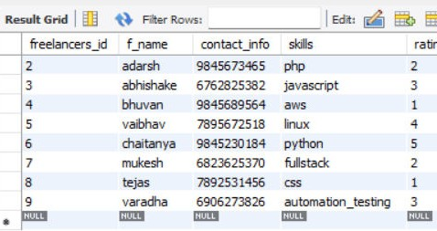
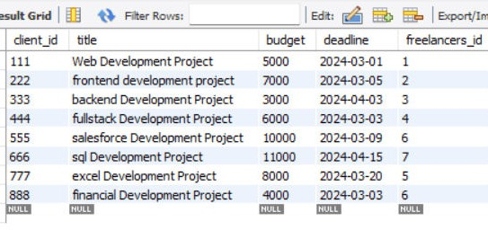
FREELANCERS TABLE
NEWPROJECT TABLE

Slide 5
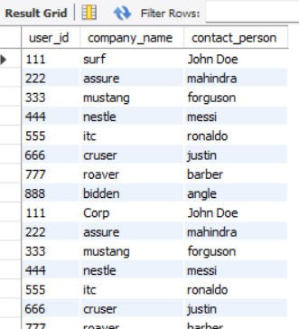
CLIENTS TABLE

Slide 6
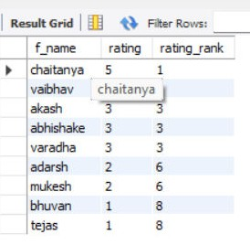
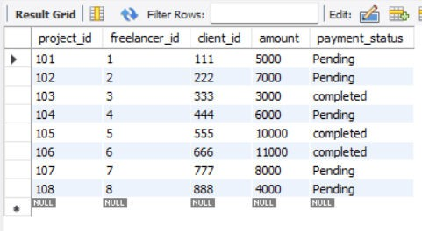
TRANSACTIONS TABLE
LOCATION TABLE

Slide 7
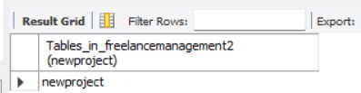
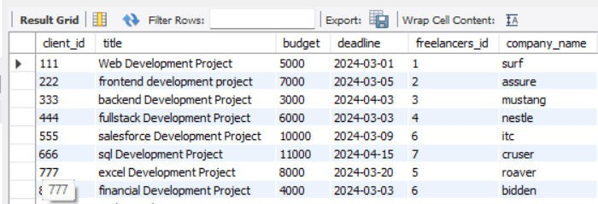
l. "Does the 'newproject' table exist in the database, and if so, what information is available about it?"
SHOW TABLES LIKE 'newproject';
2."What is
the detailed information about each
project,
including project details from 'newproject'
and the
corresponding company name from 'clients'?"
CREATE VIEW project_details AS SELECT np.*, c.company_name FROM newproject np JOIN clients c ON np.client_id = c.user_id;

Slide 8
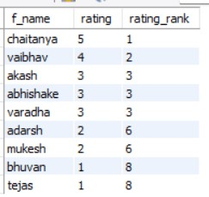
h ig h e ws th raattisn
3 ."W h ic h fre e la n c e rs h a v e th e th e ir ra n k in g b a s e d o n ra tin g ? "
SELECT f_name, rating, RANK() OVER (ORDER BY rating DESC) AS
rating_rank FROM freelancer;

Slide 9
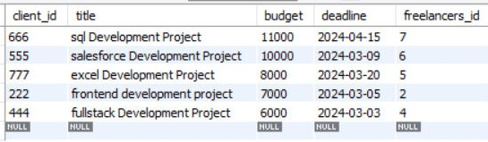
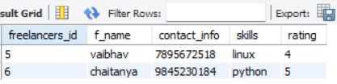
4."What are the top 5 projects with the highest budgets, and what are their details?"
SELECT * FROM newproject ORDER BY
budget DESC LIMIT 5;
5. Which freelancers are located in India, and what are their details?"
SELECT f.* FROM freelancer f
JOIN location l ON f.freelancers_id = l.freelancers_id
WHERE l.country = 'INDIA';

Slide 10
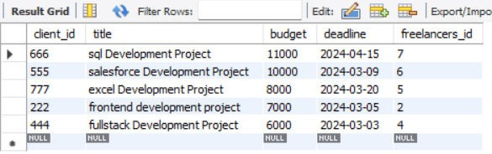
6 . " W h a t a re th e to ta l b u d g e ts
a llo c sa tfeodr teoa
c lie n t, a n d h o w d o e s it v a ry a c ro s s d iffe re n t c o
SELECT c.user_id, c.company_name, SUM(np.budget) AS total_budget FROM clients c JOIN newproject np ON c.user_id = np.client_id GROUP BY c.user_id, c.company_name;

Slide 11
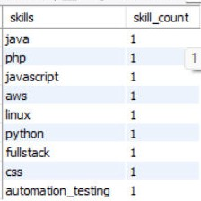
7."What is the distribution of skills among freelancers, and how many freelancers possess each skill?"
SELECT skills, COUNT(*) AS skill_count FROM freelancer GROUP BY skills;

Slide 12
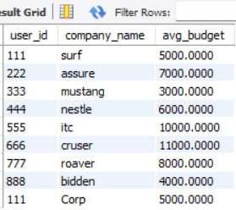
8."What is the average budget allocated to projects for each
client, and how does it vary among different companies?"
SELECT c.user_id, c.company_name,
AVG(np.budget) AS
avg_budget FROM clients c JOIN newproject np ON c.user_id = np.client_id
GROUP BY c.user_id, c.company_name;

Slide 13

9."Which clients have successfully completed projects in the USA, and what are their details?"
SELECT DISTINCT c.* FROM clients c JOIN newproject np ON c.user_id = np.client_id JOIN transactions t ON np.client_id = t.client_id WHERE t.payment_status = 'completed' AND EXISTS ( SELECT 1 FROM
location l WHERE l.country = 'USA' AND l.project_id = t.project_id );

Slide 14
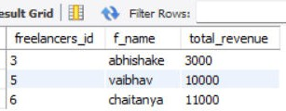
10 ." W h a t is th e to ta l re v e n u e e a rn e d b y e aucgh hf
c o m p le te d tra n s a c tio n s , a n d w h o a re th e to p - fre e la n c e rs b a s e d o n th e ir to ta l re v e n u e ? "
SELECT f.freelancers_id, f.f_name, SUM(t.amount) AS total_revenue FROM freelancer f LEFT JOIN transactions t ON f.freelancers_id = t.freelancer_id WHERE t.payment_status = 'completed' GROUP BY f.freelancers_id, f.f_name;

Slide 15
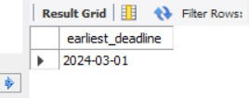
11." W h e n is th e e a rlie s t d e a d lin e a m n e w p ro je c t ta b le ? "
o n g ahlel th
SELECT MIN(deadline) AS earliest_deadline FROM newproject;

Slide 16
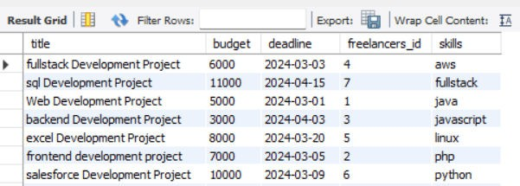
12 ." W h a t a re th e d is tin c t p ro je c t d e ta,iblsu,ding ce ltu, d e a d lin e , fre e la n c e r 's ID, a n d th e ir s k ilelse,lsaon rctee s k ills ? "
SELECT DISTINCT np.title, np.budget, np.deadline, np.freelancers_id, f.skills FROM newproject np JOIN freelancer f ON np.freelancers_id = f.freelancers_id ORDER BY f.skills;

